Slide 1
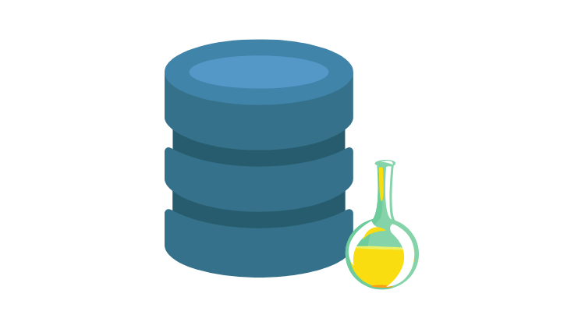
Husseinnasser.com
Updated-Oct/2021
ACID
Atomicity, Consistency, Isolation and Durability in
Relational Database Systems

Slide 2
Agenda
What is a Transaction?
Atomicity
Isolation
Consistency
Durability
Quiz

Slide 3

What is a Transaction?

Slide 4
Transaction
A collection of queries
One unit of work
E.g. Account deposit (SELECT, UPDATE, UPDATE)

Slide 5
Transaction Lifespan
Transaction BEGIN
Transaction COMMIT
Transaction ROLLBACK
Transaction unexpected ending = ROLLBACK (e.g. crash)

Slide 6
Nature of Transactions
Usually Transactions are used to change and modify data
However, it is perfectly normal to have a read only transaction
Example, you want to generate a report and you want to get consistent snapshot based at the time of transaction
We will learn more about this in the Isolation section

Slide 7
Transaction
ACCOUNT_ID | BALANCE
1 | $1000
2 | $500
$900
$900
$600
$600
Send $100 From Account 1 to Account 2
BEGIN TX1
SELECT BALANCE FROM ACCOUNT WHERE ID = 1
BALANCE > 100
UPDATE ACCOUNT SET BALANCE = BALANCE - 100 WHERE ID = 1
UPDATE ACCOUNT SET BALANCE = BALANCE + 100 WHERE ID = 2
COMMIT TX1

Slide 8
Summary
What is a Transaction?
The transaction is a collection of queries that are treated as a single unit to a fork. Transaction could change data, or it could be only read only as well.

Slide 9
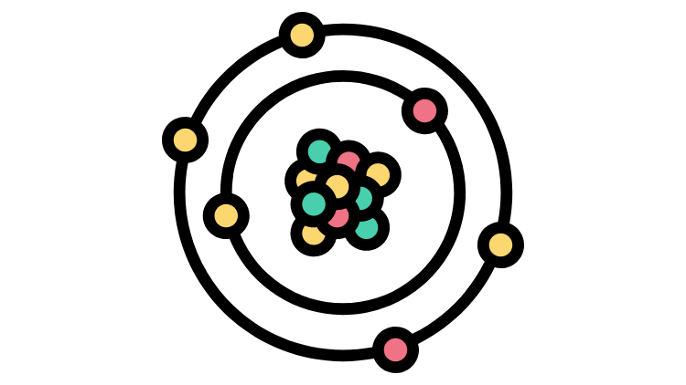
Atomicity

Slide 10
Atomicity
All queries in a transaction must succeed.
If one query fails, all prior successful queries in the transaction should rollback.
If the database went down prior to a commit of a transaction, all the successful queries in the transactions should rollback

Slide 11
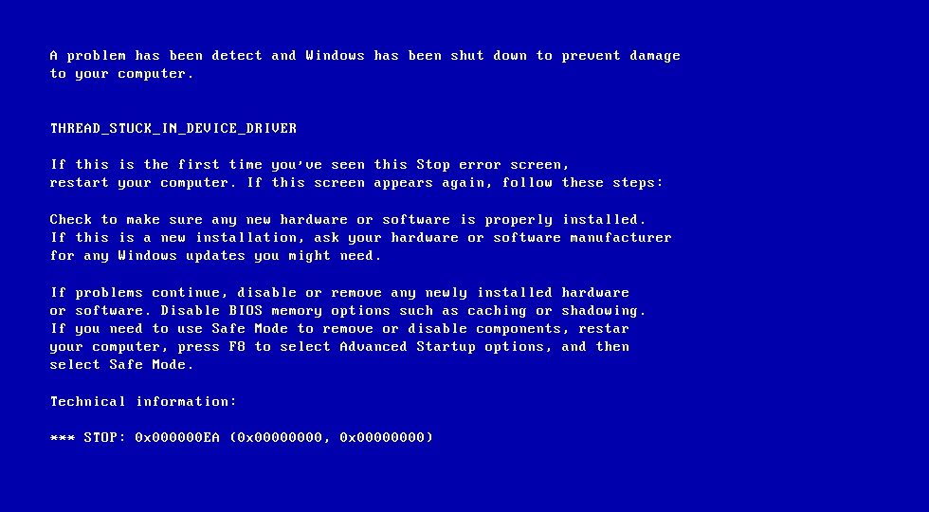
Atomicity
ACCOUNT_ID | BALANCE
1 | $1000
2 | $500
$900
Send $100 From Account 1 to Account 2
BEGIN TX1
SELECT BALANCE FROM ACCOUNT WHERE ID = 1
BALANCE > 100
UPDATE ACCOUNT SET BALANCE = BALANCE - 100 WHERE ID = 1

Slide 12
Atomicity
ACCOUNT_ID | BALANCE
1 | $900
2 | $500
After we restarted the machine the first account has been debited but the other account has not been credited.
This is really bad as we just lost data, and the information is inconsistent
An atomic transaction is a transaction that will rollback all queries if one or more queries failed.
The database should clean this up after restart.

Slide 13
Summary
Atomicity
The atomicity is the idea of the transaction being one unit of work and that cannot be split.
So if you have a transaction with 100 queries, all these hundred ways should succeed. If any of these 100 query fail, all the 100 or anything that is successful in the query should be rolled back.
And not only that, but you should even in the case of a crash in the database. So that’s not an actual explicit failure by the user. That should also roll back the changes.

Slide 14

Isolation

Slide 15
Isolation
Can my inflight transaction see changes made by other transactions?
Read phenomena
Isolation Levels

Slide 16
Isolation - Read phenomena
Dirty reads
Non-repeatable reads
Phantom reads
Lost updates

Slide 17
Dirty Reads
SALES
PID | QNT | PRICE
Product 1 | 10 | $5
Product 2 | 20 | $4
10
15
parallel
BEGIN TX1
BEGIN TX2
SELECT PID, QNT*PRICE FROM SALES
Product 1, 50
Product 2, 80
UPDATE SALES SET QNT = QNT+5
WHERE PID =1
SELECT SUM(QNT*PRICE) FROM SALES
We get $155 when it should be $130
We read a “dirty” value that has not been committed
COMMIT TX1
ROLLBACK TX2

Slide 18
Non-repeatable read
SALES
PID | QNT | PRICE
Product 1 | 10 | $5
Product 2 | 20 | $4
15
15
BEGIN TX1
BEGIN TX2
SELECT PID, QNT*PRICE FROM SALES
Product 1, 50
Product 2, 80
UPDATE SALES SET QNT = QNT+5
WHERE PID =1
COMMIT TX2
SELECT SUM(QNT*PRICE) FROM SALES
We get $155 when it should be $130
We did read a committed value, but it gave us inconsistent results
COMMIT TX1

Slide 19
Phantom read
SALES
PID | QNT | PRICE
Product 1 | 10 | $5
Product 2 | 20 | $4
BEGIN TX1
Product 3 | 10 | 1
Product 3 | 10 | $1
SELECT PID, QNT*PRICE FROM SALES
BEGIN TX2
Product 1, 50
Product 2, 80
INSERT INTO SALES
VALUES (‘Product 3’, 10, 1)
COMMIT TX2
SELECT SUM(QNT*PRICE) FROM SALES
We get $140 when it should be $130
We read a committed value that showed up in our range query
COMMIT TX1

Slide 20
Lost updates
SALES
PID | QNT | PRICE
Product 1 | 10 | $5
Product 2 | 20 | $4
20
15
BEGIN TX1
BEGIN TX2
UPDATE SALES SET QNT = QNT+10
WHERE PID =1
UPDATE SALES SET QNT = QNT+5
WHERE PID =1
COMMIT TX2
SELECT SUM(QNT*PRICE) FROM SALES
We get $155 when it should be $180
Our update was overwritten another transaction and as a result “lost”
COMMIT TX1

Slide 21
Isolation - Isolation Levels for inflight transactions
Read uncommitted - No Isolation, any change from the outside is visible to the transaction, committed or not.
Read committed - Each query in a transaction only sees committed changes by other transactions
Repeatable Read - The transaction will make sure that when a query reads a row, that row will remain unchanged while its running.
Snapshot - Each query in a transaction only sees changes that have been committed up to the start of the transaction. It's like a snapshot version of the database at that moment.
Serializable - Transactions are run as if they serialized one after the other.
Each DBMS implements Isolation level differently
Notes:
Snapshot: When I say a version of the database, I’m not talking abut actual backup.
Serializable means there are no concurrency anymore, just one after the other. So it’s so slow.

Slide 22
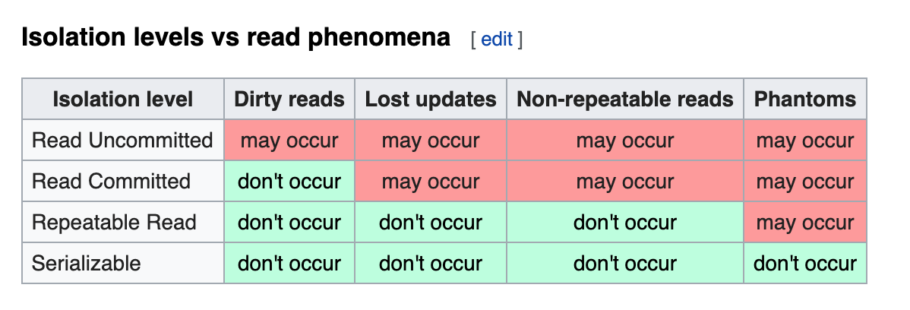
Isolation Levels vs read phenomena
https://en.wikipedia.org/wiki/Isolation_(database_systems)
Notes:
Mysql acid: https://dev.mysql.com/doc/refman/8.0/en/mysql-acid.html

Slide 23
Postgres vs Mysql
Read Committed is the default isolation level in PostgreSQL.
Repeatable Read is the default isolation level in Mysql.

Slide 24
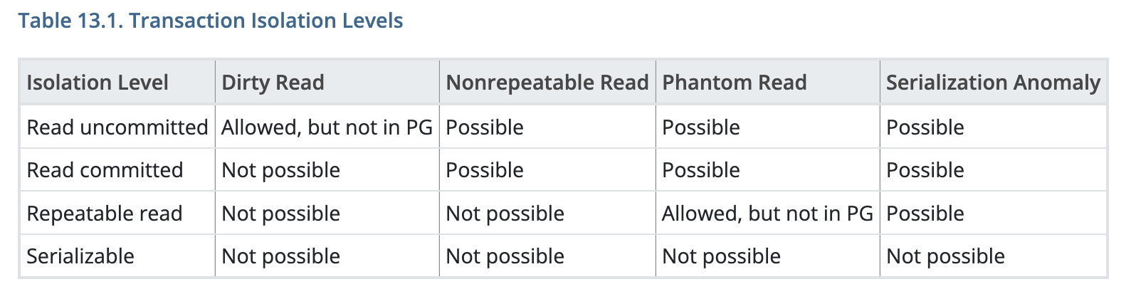
Postgres Transaction isolation levels
In PostgreSQL, you can request any of the four standard transaction isolation levels, but internally only three distinct isolation levels are implemented, i.e., PostgreSQL's Read Uncommitted mode behaves like Read Committed. This is because it is the only sensible way to map the standard isolation levels to PostgreSQL's multiversion concurrency control architecture.
Notes:
For Postgres: phttps: //www.postgresql.org/docs/current/transaction-iso.htmlostgres acid: Read Committed Isolation Level: In effect, a SELECT query sees a snapshot of the database as of the instant the query begins to run. Repeatable Read Isolation Level: This level is different from Read Committed in that a query in a repeatable read transaction sees a snapshot as of the start of the first non-transaction-control statement in the transaction, not as of the start of the current statement within the transaction. Thus, successive SELECT commands within a single transaction see the same data, i.e., they do not see changes made by other transactions that committed after their own transaction started. Postgres repeatable read is actually a snapshot.

Slide 25
Database Implementation of Isolation
Each DBMS implements Isolation level differently
Pessimistic - Row level locks, table locks, page locks to avoid lost updates
Optimistic - No locks, just track if things changed and fail the transaction if so
Repeatable read “locks” the rows it reads but it could be expensive if you read a lot of rows, postgres implements RR as snapshot. That is why you don’t get phantom reads with postgres in repeatable read
Serializable are usually implemented with optimistic concurrency control, you can implement it pessimistically with SELECT FOR UPDATE
Notes:
RR = Repeatable Read

Slide 26
Summary
Isolation
Isolation is the result of having the transaction run in complete isolation from other concurrent transactions. As a result, we get rid phenomenons and we have a lot of isolation levels that have been invented to fix great phenomenons.

Slide 27

Consistency

Slide 28
Consistency
Consistency in Data
Consistency in reads

Slide 29
Consistency in Data
Defined by the user(whomever builds out the data model and database)
Referential integrity (foreign keys)
Atomicity
Isolation
Notes:
And the user is essentially whoever designed the database.

Slide 30
Consistency in Data
Pictures
Picture_Likes
ID (PK) | BLOB | LIKES
1 | xx | 2
2 | xx | 1
USER (PK) | PICTURE_ID (PK)(FK)
Jon | 1
Edmond | 1
Jon | 2

Slide 31
Spot inconsistency in this data
Pictures
Picture_Likes
ID (PK) | BLOB | LIKES
1 | xx | 5
2 | xx | 1
USER (PK) | PICTURE_ID (PK)(FK)
Jon | 1
Edmond | 1
Jon | 2
Edmond | 4
Notes:
So someone deleted this picture, but they didn’t have a cascading event to delete the likes picture.

Slide 32
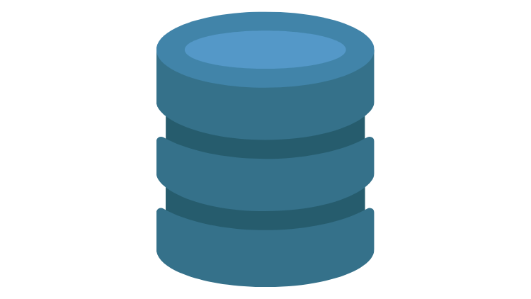
Consistency in reads
Update X
X
Read
X

Slide 33
Consistency in reads
If a transaction committed a change will a new transaction immediately see the change?
Affects the system as a whole
Relational and NoSQL databases suffer from this
Eventual consistency

Slide 34
Summary
Consistency
Consistency are two types consistent in the data which are enforced by the referential integrity. Things that have persisted in the data. And there is no eventual consistency coming out of that because the data will become kind of corrupted based on what you define by corruption here. And the different type is consistency and read. The consistency in read is when you update the value and then a transaction tries to read that value after it was committed, you get the old version and that’s an inconsistent result, right? So it was most database heal from this kind of inconsistency by eventual consistency. So that means as their application process completes, you will eventually get the final result effectively from that read. And this can be enforced by something called synchronous replication. Synchronous replication versus asynchronous replication one is slower than the other. But one give you a strong consistency on the other give you a virtual because this is different.

Slide 35

Durability

Slide 36
Durability
Changes made by committed transactions must be persisted in a durable non-volatile storage.
Durability techniques
WAL - Write ahead log
Asynchronous snapshot
AOF

Slide 37
Durability - WAL
Writing a lot of data to disk is expensive (indexes, data files, columns, rows, etc..)
That is why DBMSs persist a compressed version of the changes known as WAL (write-ahead-log segments)

Slide 38
Durability - OS Cache
A write request in OS usually goes to the OS cache(It didn’t write to the disk)
When the writes go the OS cache, an OS crash, machine restart could lead to loss of data
Fsync OS command forces writes to always go to disk
fsync can be expensive and slows down commits

Slide 39
Summary
Durability
Durability is the ability to persist that changes when the transaction committed, the emphasis on the one transaction commits. So when the transaction commence, I want you to have persisted on desk. I don’t care where he persisted. Here’s what I want. When you tell me it’s committed, I can shut off the power at that exact moment. And when I come back, my data better be there. That’s what durability means. I don’t care going to store it on the desk or storage. I want my data back. Crash are very rare.

Slide 40
Summary
What is a Transaction?
Atomicity
Isolation
Consistency
Durability

